Slide 1


Item Response Theory
Improve psychopathology measurement
Notes:
https://journals.sagepub.com/doi/abs/10.1177/0146621603257518?casa_token=qO3oJsvtRvEAAAAA:1HMb8gLgqe-hA7k_MTFp0opywhRtTt_RW4-4YysuvuTyq_DVIP6avGjSgjpF9NkMQxqD0B4ShtZ5
https://eric.ed.gov/?id=EJ802623

Slide 2
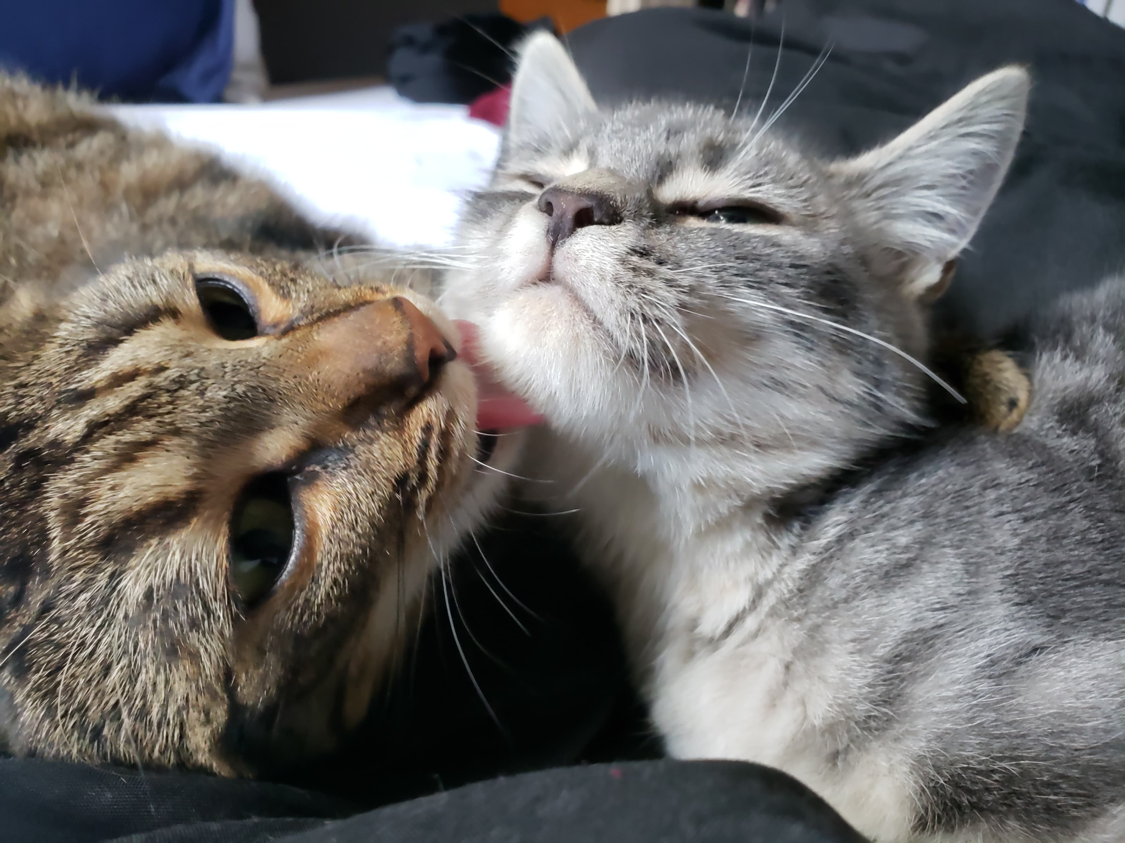
Introduction
Graduated from Oberlin College and Conservatory in May 2018
Currently work as a data analyst for Dr. Ruben Gur at the Brain Behavior Laboratory
Plan on pursuing a PhD in Clinical Psychology and an MS in Statistics

Slide 3

Ruben Gur
Professor in Psychiatry, Radiology and Neurology, and Director of the Brain Behavior Laboratory and the Center for Neuroimaging in Psychiatry
Discovered that blood flow changes when you perform a difficult cognitive task versus while at rest
Created the Computerized Neurocognitive Battery (CNB)

Slide 4
Overview
Depression measurement
PHQ-9
GOASSESS Depression
Classical Test Theory
Assumptions, Utility, Drawbacks
Item Response Theory
Assumptions, Utility, Drawbacks

Slide 5
PHQ-9 Over the past two weeks… (0-Not at all, 1-Several days, 2-More than half the days, 3-Nearly every day)
Little interest or pleasure in doing things
Feeling down, depressed, or hopeless
Trouble falling or staying asleep, or sleeping too much
Feeling tired or having little energy
Poor appetite or overeating
Feeling bad about yourself – or that you are a failure or have let yourself or your family down
Trouble concentrating on things, such as reading the newspaper or watching television
Moving or speaking so slowly that other people could have noticed. Or the opposite – being so figety or restless that you have been moving around a lot more than usual
Thoughts that you would be better off dead, or of hurting yourself
Notes:
First, what are we trying to measure here?
Second, explain scoring (i.e., add up numbers)
Ask what the limitations with this scoring method are
If you say that you have had thoughts that you would be better off dead nearly every day for the past week, not you have had no problems with eating, versus the opposite, you would get the exact same score
Items 3 and 4 largely represent the same construct
Some are more related to the construct of depression than others
Assumptions:
Continuous underlying trait
Monotonically increasing
Locally independent/ unidimensional – Probably not (see items 3 & 4)

Slide 6
GOASSESS Depression (0-No, 1-Yes)
During this time did you…
have problems falling asleep, waking up before you had to, or sleeping more than usual for you?
eat less or more, or feel less or more hungry than usual?
have trouble sitting still or feel like you had to keep moving around OR did you move or think more slowly than usual?
feel really tired or have less energy than usual?
have problems keepings your mind on things (like homework), remembering things, thinking clearly or making decisions?
blame yourself for bad things that happened or feel like you didn’t really matter?
Has there ever been a time…
when you felt sad or depressed most of the time?
when you cried a lot, or felt like crying?
when you felt grouchy, irritable, or in a bad mood most of the time; even little things would make you mad?
when nothing was fun for you and you just weren’t interested in anything? (Continue if most of day for at least 1 week)
Notes:
Assumptions:
Continuous underlying trait
Monotonically increasing
Locally independent/ unidimensional

Slide 7

Classical Test Theory: Assumptions
Unidimensional: The underlying trait score being estimated represents one continuous construct (e.g., lifetime depression severity)
Monotonically increasing: As severity ($θ$) increases, the probability of responding “yes” (or a higher response category) to any given item ($Ρ(X=1)$) also increases
Exchangeable: Given $θ,$the probability of Person A responding $σ$ to one item (X) is equal to the probability of Person B responding $σ$ to a different item (Y) for every pair of items (IID) $P\left(X=σ , Y=σ│A=θ,B=θ\right)=P(X=σ|A=θ)P(Y=σ|B=θ)$ $P\left(X=σ | A=θ\right)=P(Y=σ|B=θ)$
Notes:
Exchangeable: conditional on theta, the distributions of the item responses are independent and identically distributed

Slide 8
CTT: Utility
Quick: Get trait estimates with a simple sum score
Common: Almost everyone scores surveys this way
Interpretable: For yes/no items, it represents the number of symptoms endorsed

Slide 9
CTT: Drawbacks
SURVEYS ARE RARELY UNIDIMENSIONAL
PHQ #3: Trouble falling or staying asleep, or sleeping too much
PHQ #4: Feeling tired or having little energy
EXCHANGEABILITY ASSUMPTION ALMOST NEVER TRUE
Different items endorsed at different rates, given the trait level
PHQ #5: Poor appetite or overeating
PHQ #9: Thoughts that you would be better off dead, or of hurting yourself
Notes:
* Including only people 1+ SDs above mean

Slide 10

Item Response Theory: Assumptions
Unidimensional: The underlying trait score being estimated represents one continuous construct (e.g., lifetime depression severity)
Monotonically increasing: As severity ($θ$) increases, the probability of responding “yes” to any given item ($Ρ(X=1)$) also increases
Locally (or conditionally) independent: Given theta, the probabilities of responding “yes” to any pair of items are independent (I), but not necessarily identically distributed (not ID) $P\left(X=σ , Y=σ│A=θ,B=θ\right)=P(X=σ|A=θ)P(Y=σ|B=θ)$ $P\left(X=σ | A=θ\right)≠P(Y=σ|B=θ)$
Notes:
conditional on theta, the distributions of the item responses are independent, but not necessarily identically distributed

Slide 11




IRT: Utility
Pretty Quick: With some basic knowledge of R, can easily implement (see packages: psych, mirt, lordif, etc.)
Common in psychometrics: All standardized tests, including adaptive ones, are based on some IRT model
Better estimate of trait: By not assuming exchangeability, trait estimates are more accurate
Detect bad items and responders
Notes:
Detect bad items and responders: person fit

Slide 12
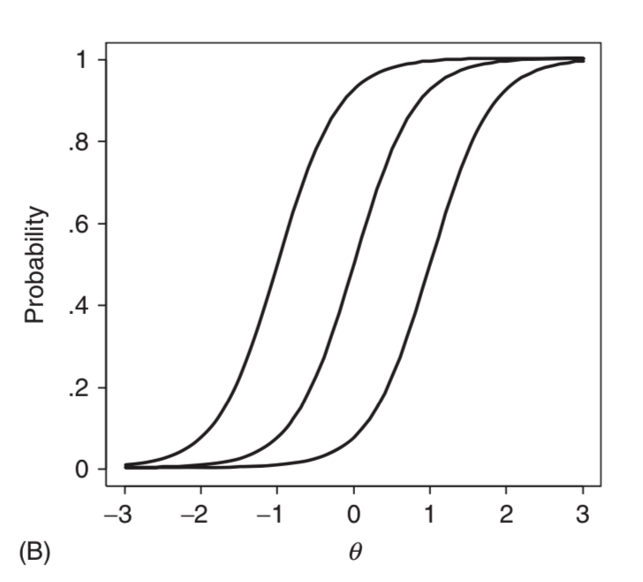

Types of IRT Models: 1-Parameter Logistic
$P\left(X=1 | θ\right)=e^{θ−b}/(1+e^{θ−b}$), where b is the item location parameter

Slide 13
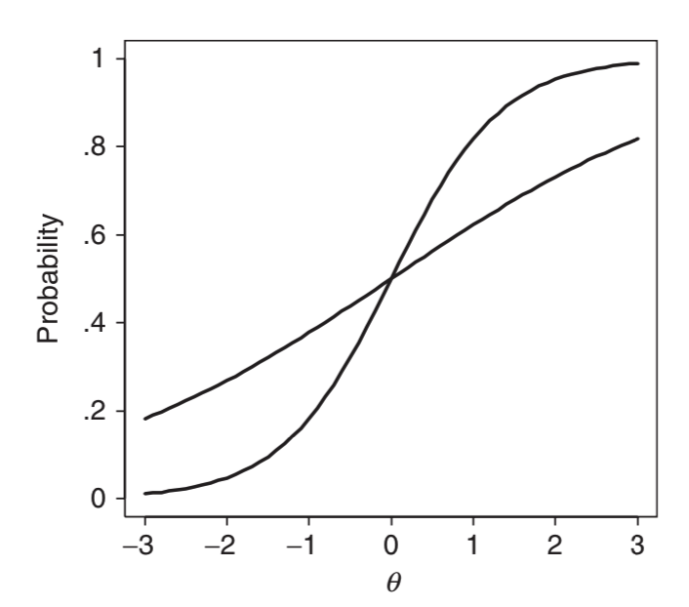

Types of IRT Models: 2-Parameter Logistic
$P\left(X=1 | θ\right)=e^{a(θ−b)}/(1+e^{a(θ−b)}$), where a is the item discrimination parameter

Slide 14
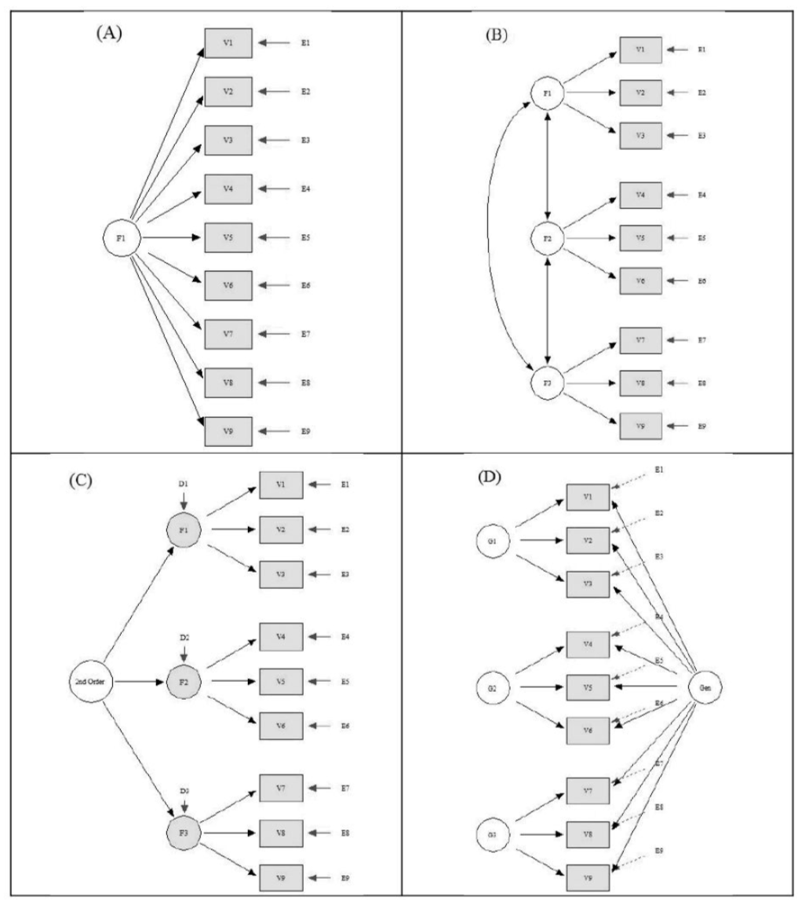
And many others!
Unidimensional
1PL
2PL
3PL
…
Multidimensional
Correlated Traits
Second-Order
Bifactor

Slide 15

IRT: Drawbacks
Need a lot of data: To accurately estimate parameters, you’ll need more and more data as your models get more complex
Risk of over-fitting: Model fit indices will often indicate that more complex models are better, but not always true
Requires knowledge: Fitting IRT models isn’t easy. But all good science is difficult 🤷‍♀️
Not enough data? Not enough expertise? Use scales that have already been calibrated
Notes:
http://www.healthmeasures.net/explore-measurement-systems/promis

